Slide 1
OneWorld Prosthetics
Information security Management System proposal
Module Name: UFCFRB-15-3 - Security management in practice
Student Names and Numbers:
Avleen Kaur Sidhu - 20049489
Joe Coleman - 25026245
Sam Fussell- 25033324

Slide 2
Agenda
2
Our organization and goals
Roles within the organization
Our company’s assets
Vulnerabilities and Threats (a mini risk assessment)
What is the potential impact of these risks?
Case studies and what we can learn from them
Which ISMS frame-work do we recommend?
Regulations that apply to us
Key challenges we face with this proposal
Solutions to these challenges

Slide 3
Our organization and goals

Slide 4

Roles within the organization
4

Slide 5
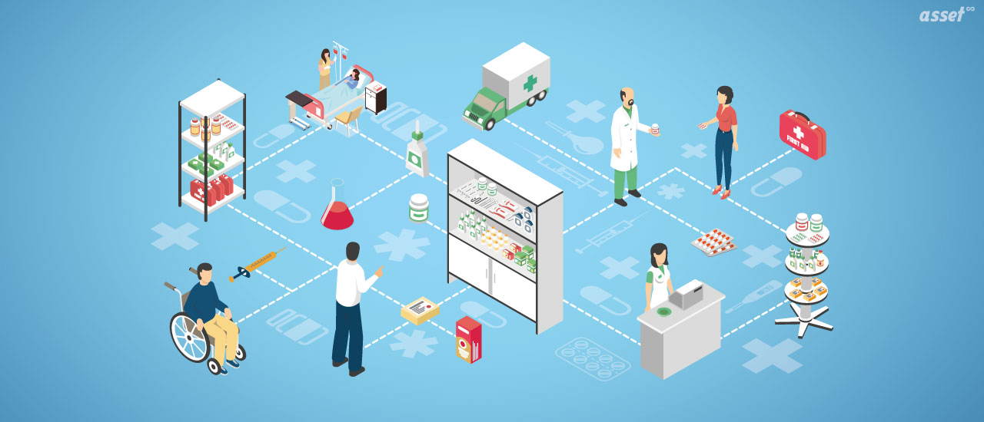
Our company's assets
5
Patient data (dates of birth, emails, phone, addresses, insurance information)
Staff data (logins etc.)
Financial donor data
Electrical/mechanical equipment
Financial and billing data
Databases
Medical IoT devices
Workstations and mobile devices

Slide 6
Vulnerabilities and Threats (a mini risk assessment)
Phishing
Ransomware
Insider threats
Iot devices
Older it systems

Slide 7
What is the potential impact of these risks?
Loss of repuation
Financial costs
Legal repercusions
Thef of of intellectual property
Identity theft and fraud
Daily operations affected

Slide 8

Case studies and what we can learn from them
WannaCry (2017)
Shields Healthcare Group (2022)
Change Healthcare (2024)
Universal Health Services (2020)

Slide 9
Which isms framework do we recommend?
Improved incident response times
In depth
ISO/IEC 27001
-clear, organised
Shows our stakeholders we’re prepared!

Slide 10
Regulations that apply to us
General Data Protection Regulation (GDPR)
NHS data security and privacy requirements + MHRA
PCI DSS
HIPPA

Slide 11
Key challenges we face with this ISMS proposal
Financial costs
User adoption
Resource limitations

Slide 12
Solutions to these challenges
Phased implementation approach
Staff awareness and training
Strong leadership

Slide 13
Thank You
OneWorld Prosthetics Security Information Management Team
smip@oneworldpro.org.net
01981 250 201

Slide 14
References
BMA (2024) Cybersecurity: cracks in the system. [online]
Available at: https://thedoctor.bma.org.uk/articles/health-society/cybersecurity-cracks-in-the-system/
(Last accessed: 10/03/2026).
CDC (2024) Health Insurance Portability and Accountability Act of 1996 (HIPAA). [online] Available at: https://www.cdc.gov/phlp/php/resources/health-insurance-portability-and-accountability-act-of-1996-hipaa.html
(Last accessed: 10/03/2026).
CoverLink (2024) Cyber case study: Change Healthcare cyberattack. [online]
Available at: https://coverlink.com/cyber-liability-insurance/cyber-case-study-change-healthcare-cyberattack/
(Last accessed: 10/03/2026).
Cyberday (2024) Best practices and common challenges of ISMS implementation. [online]
Available at: https://www.cyberday.ai/blog/best-practices-and-common-challenges-of-isms-implementation
(Last accessed: 10/03/2026).
DataGuard (2024) Benefits of ISO 27001. [online]
Available at: https://www.dataguard.com/iso-27001/benefits/
(Last accessed: 10/03/2026).
GOV.UK (2024) Data protection. [online]
Available at: https://www.gov.uk/data-protection
(Last accessed: 10/03/2026).
HIPAA Journal (2024) Shields Health Care data breach settlement. [online]
Available at: https://www.hipaajournal.com/shields-health-care-data-breach-settlement/
(Last accessed: 10/03/2026).

Slide 15
References continued
ISMS.online (2024) ISO 27001 implementation: 4 key challenges and how to overcome them. [online]
Available at: https://www.isms.online/iso-27001/iso-27001-implementation-4-key-challenges-how-to-overcome-them/
(Last accessed: 10/03/2026).
ISO (2022) ISO/IEC 27001 Information security management. [online]
Available at: https://www.iso.org/standard/27001
(Last accessed: 10/03/2026).
NAO (2017) Investigation: WannaCry cyber attack and the NHS. [online]
Available at: https://www.nao.org.uk/wp-content/uploads/2017/10/Investigation-WannaCry-cyber-attack-and-the-NHS.pdf
(Last accessed: 10/03/2026).
NHS England (2024) Security and privacy: NHS federated data platform. [online] Available at: https://www.england.nhs.uk/digitaltechnology/nhs-federated-data-platform/security-privacy/
(Last accessed: 10/03/2026).
Omni Cybersecurity (2024) PCI DSS security standards. [online]
Available at: https://www.omnicybersecurity.com/cybersecurity-services/pci-dss-get-your-quote/?utm_term=pci%20security%20standards&utm_campaign=PCI&utm_source=adwords&utm_medium=ppc&hsa_acc=4926433472&hsa_cam=22180601270&hsa_grp=189600267756&hsa_ad=786653023430&hsa_src=g&hsa_tgt=kwd-1834754351&hsa_kw=pci%20security%20standards&hsa_mt=e&hsa_net=adwords&hsa_ver=3&gad_source=1&gad_campaignid=22180601270&gbraid=0AAAAACvITjo4r6x9KX-GGY6hCTlB8R2mZ&gclid=Cj0KCQjwgr_NBhDFARIsAHiUWr7N5IM-gfEj7ZufNplL88ztXRpdYzWRTVPa4nLMGjLhJQQk0rY_jGEaAif9EALw_wcB
(Last accessed: 10/03/2026).
Rubrik (2025) Healthcare cybersecurity challenges and threats. [online]
Available at: https://www.rubrik.com/insights/healthcare-cybersecurity-challenges-threats-2025
(Last accessed: 10/03/2026).
TUV NORD (2024) Common challenges in implementing ISO 27001 and how to overcome them. [online]
Available at: https://www.tuv-nord.com/uk/en/common-challenges-in-implementing-iso-27001-and-how-to-overcome-them/
(Last accessed: 10/03/2026).

